Slide 1
ReactJS
A Case Study
Rich Web Application Technology

Slide 2
Everything is a Component
ReactJS was started at Facebook and open-sourced in 2013
Its principal abstraction is the web component and this drives the entire design philosophy of a Web App in ReactJS
Apps are constructed as a hierarchy of nested components responsible for rendering to the DOM, handling user events, link navigation and App state management
Modeling everything as a component may seem incongruous at first but it the advantage is that there is only one big idea to learn and understand
React supports the construction and maintenance of very large applications across a distributed set of developers
Notes:
It’s generally more fun, easier, and overall a smoother experience to work with tools that have a vibrant community, a robust ecosystem, and a diversity of contributor experience and background.
React started as a small project but now has broad popularity and a vibrant community. No community is perfect, and React’s isn’t either, but as far as open source communities go, it has many important ingredients for success
Bunch of companies that use react
Facebook Netflix New Relic Uber Wealthfront Heroku PayPal
BBC Microsoft NFL And more! Asana ESPN Walmart
React is a fairly lightweight library in terms of responsibility and functionality. Where something like Angular may require you to “buy in” to a more comprehensive API, React is only concerned with the view of your application. This means it’s much more trivial to integrate it with your current technologies, and it will leave you room to make choices about other aspects.

Slide 3
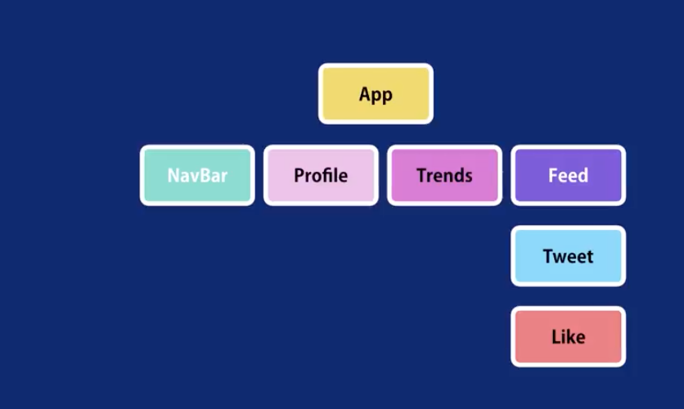
Everything is a Component Cont..
Twitter as components
Notes:
It’s generally more fun, easier, and overall a smoother experience to work with tools that have a vibrant community, a robust ecosystem, and a diversity of contributor experience and background.
React started as a small project but now has broad popularity and a vibrant community. No community is perfect, and React’s isn’t either, but as far as open source communities go, it has many important ingredients for success
Bunch of companies that use react
Facebook Netflix New Relic Uber Wealthfront Heroku PayPal
BBC Microsoft NFL And more! Asana ESPN Walmart
React is a fairly lightweight library in terms of responsibility and functionality. Where something like Angular may require you to “buy in” to a more comprehensive API, React is only concerned with the view of your application. This means it’s much more trivial to integrate it with your current technologies, and it will leave you room to make choices about other aspects.

Slide 4
Everything is Javascript
Even though a ReactJS App looks more like a typical W3C-standards App with its use of HTML-like markup and CSS, a ReactJS App is, in fact, a pure JS App
All developer-authored code is just a shim of one kind or another over native JS and, ultimately, the DOM API
In this way, ReactJS can also be considered to be an abstracted layer above the native browser technologies which takes full control over the App expression and translates this transparently way to the end-user
This architectural approach has allowed ReactJS to be ported, mostly intact, to build native Apps on mobile platforms such as iOS and Android
Notes:
Go to babel js repl - https://babeljs.io/en/repl
Type
const h1 = <h1>This is a heading</h1>
My personal preference is toward the choose­your­own, does­one­thing­well approach, but that’s really neither here nor there; it’s all about tradeoffs. React doesn’t come with opinionated solutions for HTTP, routing, data modeling (although it certainly has opinions about data flow in your views, which we’ll get to), or other things you might see in something like Angular
One upside to the flexible approach of React is that you’re free to pick the best tools for the job. Don’t like the way X HTTP library works? No problem—swap it out for something else. Prefer to do forms in a different way? Implement it, no problem. React provides you with a set of powerful primitives to work with
t’s an unavoidable fact that JavaScript frameworks are rarely truly interoperable; you can’t usually have an app that’s part Angular, part Ember, part Backbone, and part React, at least not without segmenting off each part or tightly controlling how they interact

Slide 5
JSX
The DOM markup language in React is called JSX
JSX is really Javascript and not HTML but supports a markup-like syntax for convenience
In reality, the markup directives are just aliases for the (less-readable) JS function equivalents
<div> <img src="avatar.png" className="profile" /> <h3>{[firstName, lastName].join(' ')}</h3> </div> | React.createElement("div", null, React.createElement("img", { src: "avatar.png", className: "profile" }), React.createElement("h3", null, [firstName, lastName].join(" ")) );
Notes:
In the example shown, we see a JSX fragment as a <div> container element containing an <img> element and a <h3> element
The curly-braces is the JS expression expansion syntax wherein arbiratry JS code can be injected into the JSX templates - remember JSX is, itself actually JS

Slide 6
Bootstrapping
To help with creating conventions, the ReactJS authors have provided a handy command-line interface to bootstrap the generation of a ReactJS App `npx create-react-app my-app` - need Node JS installed.
The create-react-app CLI, which can be installed as an Node JS module, automatically generates a folder structure and populates some boilerplate code snippets
This gives developers an important start allowing them to get up and running quickly in what could otherwise be a complex task, particularly as it applies to the build system and the automatic code reloading
https://reactjs.org/docs/create-a-new-react-app.html#create-react-app

Slide 7
The Virtual DOM
By intercepting all rendering via JSX, ReactJS maintains a shadow copy of the real browser DOM called the virtual DOM
The framework tracks App-driven changes to the virtual DOM and updates the real DOM with the deltas periodically with input events flowing in the opposite direction (fast diffing)
This approach allows ReactJS to update the DOM more efficiently for better performance
Notes:
When a DOM element is accessed, modified, or created, the browser is often performing a query across a structured tree to find a given element. That’s just to access
an element, which is usually only the first part of an update. More often than not, it may have to reperform layout, sizing, and other actions as part of a mutation—all of which can tend to be computationally expensive. A virtual DOM won’t get you around this, but it can help updates to the DOM be optimized to account for these constraints
React can perform intelligent updates and only do work on parts that have changed because it can use heuristic diffing to calculate which parts of the in­memory DOM require changes to the DOM.

Slide 8
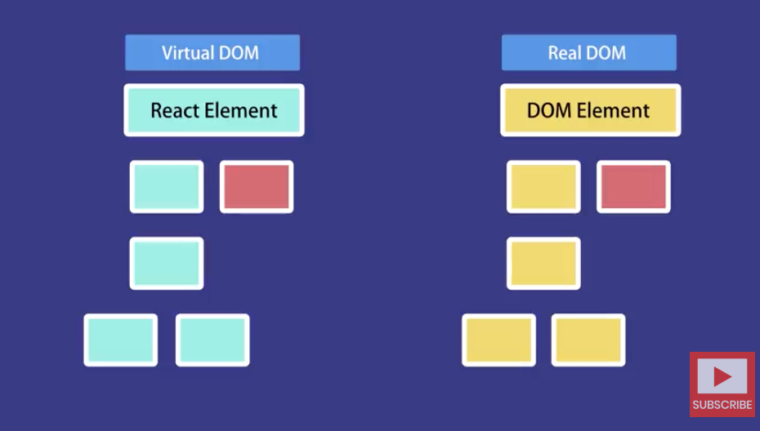
The Virtual DOM Cont..
Notes:
When a DOM element is accessed, modified, or created, the browser is often performing a query across a structured tree to find a given element. That’s just to access
an element, which is usually only the first part of an update. More often than not, it may have to reperform layout, sizing, and other actions as part of a mutation—all of which can tend to be computationally expensive. A virtual DOM won’t get you around this, but it can help updates to the DOM be optimized to account for these constraints
React can perform intelligent updates and only do work on parts that have changed because it can use heuristic diffing to calculate which parts of the in­memory DOM require changes to the DOM.

Slide 9
Stateless Function Components
There are two ways to build components in ReactJS, the first of which is the stateless function component
const Header = title => ( <h2 style={styles.title}>{title}</h2> ) . . . <Header title=“My Header Title” />
Notes:
In the example shown, we see a stateless Header component declared as an ES6 function called “Header” taking as a single argument “title”
Arguments to stateless function components are called properties in ReactJS and are the way of configuring component behaviour
The <Header /> component can then be instantiated just like any other HTML element
In this example, we pass a value for the Header title which will be expanded inside the <h2> element
This <h2> element is also styled with a styles object representing some CSS (not shown)

Slide 10
Managing App State
Application state deals with the reality that even simple applications need to deal with data and that data is likely to change over time as the user interacts with the App
For example, how would we deal with user input to a text box?
Where do we store what the user input?
This user input is an example of mutable state
The stateless function component, cannot directly deal with state
So we need another kind of component for this purpose
That kind of component is called the class component or stateful
Notes:
What are components
A component can be whatever you determine it to be, although not everything makes sense as a component. For example, if you decide that the entirety of an interface is a component, with no child components or further subdivisions, you’re probably not helping yourself. Instead, it’s helpful to break different parts of an interface into parts that can be composed, reused, and easily reorganized.
User interfaces often contain elements that are reused or repurposed in other parts of the interface
React components are well encapsulated, reusable, and composable. These characteristics help enable a simpler and more elegant way of thinking about and building user interfaces. Your application can be comprised of clear, concise groups instead of being a spaghetti­code mess. Using React to build your application is almost like building your project with LEGO

Slide 11
Stateful Class Components
A stateful component declared as a Javascript class using the ES6 class keyword
To be a ReactJS component, this class must extend the built-in React Component class
class MyComponent extends React.Component { render() { return ( ... ) } }
Notes:
•The component must also implement a single method called render()
•The render method() must return a component or a scalar quantity such as a number or boolean or null (signifying nothing to render)

Slide 12
Initialising State with this
In this basic from, a class component cannot yet be considered to have state
For this we actually need to create a state data structure
class MyComponent extends React.Component { constructor(props) { super(props) this.state = { ... } } . . . }
Notes:
•To do this we include a constructor method on our class component
•Note that a Javascript class constructor is a method named by the constructor keyword
•As you might expect, the constructor is called when the class is instantiated
•The constructor arguments will receive any properties passed to this component when is it instantiated
•We must call the superclass constructor with these (optional) properties first
•Then we create a state object on our instance state via the this keyword

Slide 13
Accessing State
The ‘this’ keyword is how we access instance data in Javascript
class MyComponent extends React.Component { constructor() { this.state = { name: “some name” } } . . render() { console.log(this.state.value) } }
Notes:
•The state object is available via the ‘this’ keyword in our class methods
•In our example, we add a name attribute, a string, to the component state in the constructor
•Later, we can access this name’s value from this.state
•So accessing state is simply a matter of reading the state object using normal Javascript syntax

Slide 14
State Mutation
Mutating state after is has been set up in the class constructor works slightly differently
class MyComponent extends React.Component { constructor() { this.state = { name: “some name” } } . . render() { this.setState({name: “a different name”}) } }
Notes:
You might think that you could just change the object’s value using a Javascript assignment
•But that’s not how it works – in fact it is an error to directly mutate state objects in this way in React JS
•Instead, we must use the setState method on this
•Our component inherits setState by virtue of extending the built-in React Component class
•Mutating state via the setState function allows React JS to check to see if any rendered user interface content needs to be refreshed
•As we shall see, there is often a tightly-coupled relationship between the state values of a class component and the displayed screen content
•In its first form, the setState function takes an object argument and merges the attribute values you pass with the instances this.state object

Slide 15
Stateful Component Lifecycle
Mounting | Updating
constructor() | componentWillReceiveProps()
componentWillMount() | shouldComponentUpdate()
render() | componentWillUpdate()
componentDidMount() | render()
 | componentDidUpdate()
Notes:
•ReactJS defines a set of lifecycle events for stateful components and a way for the App developer to take actions when each lifecycle event occurs
•React lifecycle events and hooks fall broadly into two categories
•The first category of events have to do with the point at which the stateful component comes into being and is said to be mounted
•These events occur once when the component is instantiated
•The second set of events, the updating events. can occur throughout the lifetime of the component’s existence
•The updating events can occur zero or more times depending on the nature of the component and how it is interacting with the external world
•The names that you see here are the names of class methods that you can (optionally) provide implementations for
•Your method implementations will be called by the ReactJS Framework if and when each of the associated events occurs
•The constructor for a React component is called before it is mounted. When implementing the constructor for a React.Component subclass, you should call super(props) before any other statement. Otherwise, this.props will be undefined in the constructor, which can lead to bugs.
•The constructor is the right place to initialize state. If you don’t initialize state and you don’t bind methods, you don’t need to implement a constructor for your React component.
•componentWillMount() is invoked immediately before mounting occurs.
•It is called before render(), so setting state synchronously in this method will not trigger a re-rendering.
•Of all of the lifecycle methods in the stateful component model, the render() method is the only one that you must provide
•The render method must return either another React component or a scalar quantity such as a string, number or boolean or the null value to indicate that nothing should be rendered
•componentDidMount() is invoked immediately after a component is mounted.
•Initialization that requires user output changes should go here.
•If you need to load data from a remote endpoint, this is a good place to instantiate the network request.
•Setting state in this method will trigger a re-rendering of the user interface.

Slide 16
Stateful Component Lifecycle
Mounting | Updating
constructor() | componentWillReceiveProps()
componentWillMount() | shouldComponentUpdate()
render() | componentWillUpdate()
componentDidMount() | render()
 | componentDidUpdate()
Notes:
•componentWillReceiveProps() is invoked before a mounted component receives new props.
•If you need to update the state in response to prop changes (for example, to reset it), you may compare this.props and nextProps and perform state transitions using this.setState() in this method.
•Note that React may call this method even if the props have not changed, so make sure to compare the current and next values if you only want to handle changes.
•This may occur when the parent component causes your component to re-render.
•React doesn’t call componentWillReceiveProps with initial props during mounting.
•Use shouldComponentUpdate() to let React know if a component’s output is not affected by the current change in state or props.
•The default behavior is to re-render on every state change, and in the vast majority of cases you should rely on the default behavior.
•shouldComponentUpdate() is invoked before rendering when new props or state are being received. Defaults to true.
•componentWillUpdate() is invoked immediately before rendering when new props or state are being received.
•Use this as an opportunity to perform preparation before an update occurs.
•This method is not called for the initial render.
•Note that you cannot call this.setState() here.
•If you need to update state in response to a prop change, use componentWillReceiveProps() instead.
•componentDidUpdate() is invoked immediately after updating occurs.
•This method is not called for the initial render.
•Use this as an opportunity to operate on the DOM when the component has been updated.
•This is also a good place to do network requests as long as you compare the current props to previous props (e.g. a network request may not be necessary if the props have not changed).

Slide 17
Styling Components
React components can be styled in two main ways
You can use what is known as inline styling by passing a JS object of style attributes to a component as a style property value
Or you can directly import a CSS stylesheet into your JS code and ReactJS will translate this into the appropriate DOM API calls to match
Components can be annotated with id, className and other CSS-targetable attributes as normal
const Header = title => ( <h2 style={styles.title}>{title}</h2> )

Slide 18
DOM Event Handling
DOM events are delivered to ReactJS components in the same way you would expect with normal HTML
In ReactJS, you set up on or more event handlers (callbacks) for one or more events on a particular component
class ShowAlert extends Component { showAlert() { alert("I’m an alert"); } render() { return ( <button onClick={this.showAlert}>show alert</button> ); } }
Notes:
In the example, we see a stateful class component which renders a button
When the button is clicked, the defined click handler, an instance method on the component class, is called
Note the use of the curly-braces syntax in JSX to get access to the JS class variables and functions

Slide 19
Delegation Pattern
One of the most common uses for stateful components is to act as state management containers for stateless components
<MyStatefulComponent> <StatelessComponentOne ...props1 /> <StatelessComponentTwo ...prop2> <StatelessComponentThree ...prop3 /> </StatelessComponentTwo> </MyStatefulComponent>
Notes:
•In other words, the stateless components are nested inside a stateful component which is responsible for managing any state of its nested children
•In this pattern, which works for simple Apps, there are a relatively small number of stateful components which wrap the stateless components
•The advantage here is to allow state to be managed in fewer code sites making the overall App construction less complex
•Keep this pattern in mind as we will explore this idea in more concretely in the course tutorials

Slide 20
Modules
A module is a self-contained unit of code with distinct functionality that helps with the code organisation of the App
We’ve see the value of code composition from the perspective of language features such functions and classes
The ReactJS framework supports composition through higher-order abstractions such as components as its principal philosophy
Javascript modules offer the same benefits but at the outer level of the application code
Modules help us to package functions, classes and components into distinct namespaces which can be organised and included in the App code based as required
Notes:
A module can be flexibly added or removed as necessary, without disrupting the system code as a whole
•ES6 introduced a model and new language keywords to support modules
•The new module mechanism allow developers to create modules containing specific functions, classes and objects as one or more symbols
•These symbols can be made available to external consumers (called exporting) either individually or as an entire module collection
Similarly, the module consumer can include module symbols (called importing) either individually or as an entire module

Slide 21
Application Organisation
├── README.md ├── package.json ├── public │ ├── favicon.ico │ ├── index.html │ └── manifest.json ├── src │ ├── App.css │ ├── App.js │ ├── App.test.js │ ├── index.css │ ├── index.js │ ├── logo.svg │ └── registerServiceWorker.js └── yarn.lock
Notes:
It is recommended, by convention, to create a source sub-directory named ‘components’ after you have generated the initial App skeleton with the create-react-app CLI
This is where you will all if your component code
In fact, as we shall see, the component folder will act as a containing directory for a number of other sub-directories including directories for styles, shared libraries and third-party vendor code

Slide 22
Further reading and examples
Watch youtube tutorial https://www.youtube.com/watch?v=Ke90Tje7VS0&ref=hackr.io
https://github.com/enaqx/awesome-react?ref=hackr.io
My repo - https://github.com/paul-kelly-dit/react-playground
There are 5 branches available for download
Master – initial skeleton
Branch part-2 – work with react element
Branch part-3-component – work with react component
Branch part-4-nested-component – work with nested components
Branch part-5-setting-state
Run all above branches with ‘npm install && npm start’

